Slide 1
Feasibility study to reduce Hospital’s load of wood biomass in Burundi
Fabio Riva
Prof.ssa Emanuela Colombo
Ing. Matteo Rocco
Dott. Gianmario Stefanelli

Slide 2
Summary
TO INCREASE ACCESS TO MODERN ENERGY IN BURUNDI
- Access to energy
- Burundi
- Energy sources assessment
- Technologies analysis
- Decision process
Ultimate goal
“Affordable and reliable modern energy services are essential for alleviating poverty, improving health and raising living standards”
General context
Ban Ki-moon
18 February 2014
Goals
of the
thesis
Notes:
In accordo con le parole del segretario generale delle NU, l’obiettivo principale della tesi è …. Il lavoro verrà dunque presentato attraverso un primo step che prevede l’analisi generale del contesto (ovvero il problema dell’accesso all’energia nei DCs e un assessment generale del Paese analizzato) e attraverso l’analisi dei suoi tre obiettivi fondamentali che sono …

Slide 3
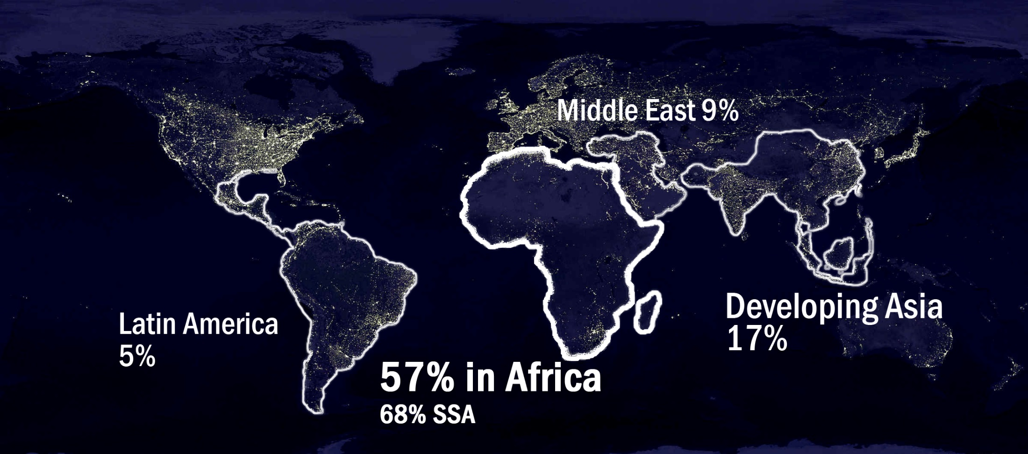
Access to energy
1.3 billion people are without access to electricity
no access to WATER and IMPROVED SANITATION FACILITY, EDUCATION
source: WEO2013 – Energy For All
Notes:
*come confermato dal WEO2014

Slide 4
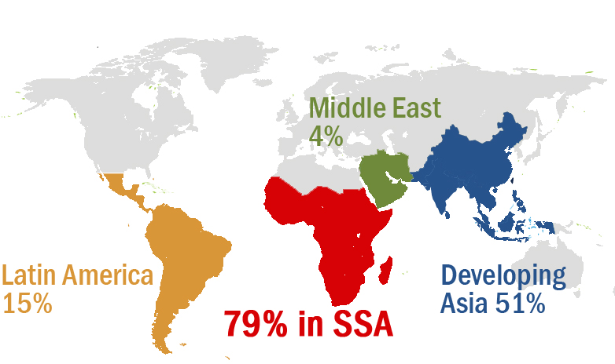
Access to energy
2.6 billion people are without access to clean cooking facilities
source: WEO2013 – Energy For All

Slide 5
Access to energy
Impact on Health:
4.3 million people a year die prematurely from illness attributable to the household air pollution caused by the inefficient use of solid fuels (WHO 2014)
Social impact:
wood collection is highly time-consuming. Especially for women and children, this limits their time available for education (FAO 2012)
Environmental impact:
more pressure on deforestation and desertification of lands (Allen and Douglas 2010 – WHO 2006)
Notes:
Nonostante ci sia in corso un dibattito su questo tema, tale problema è particolarmente evidente in Burundi → slide 6

Slide 6

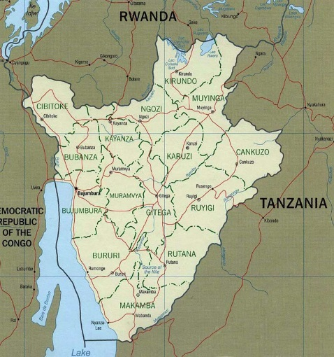
Burundi – a general and energy assessment
<1% of the population have access to Modern Cooking
source: IIASA UNIDO 2012
70.8% of TPES is met by FUEL WOOD
source: IRENA 2009
A GREAT PRESSURE ON DEFORESTATION
2.02% deforestation rate, the highest in Africa
source: WB 2013
Population (million) 10.16
GDP per capita (US$) 251.0
Life expectancy at birth (years) 53
Enrolment in secondary school (%) 28%
Human Development Index 0.355
soil erosion
siltation
social problems

Slide 7
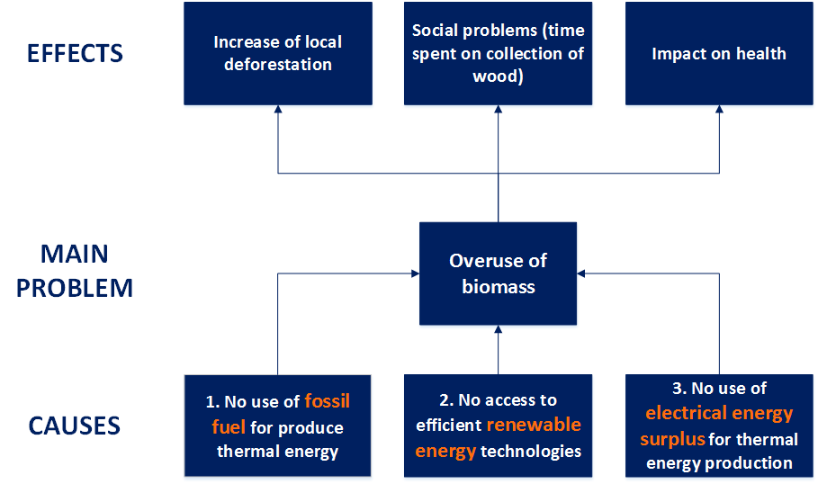
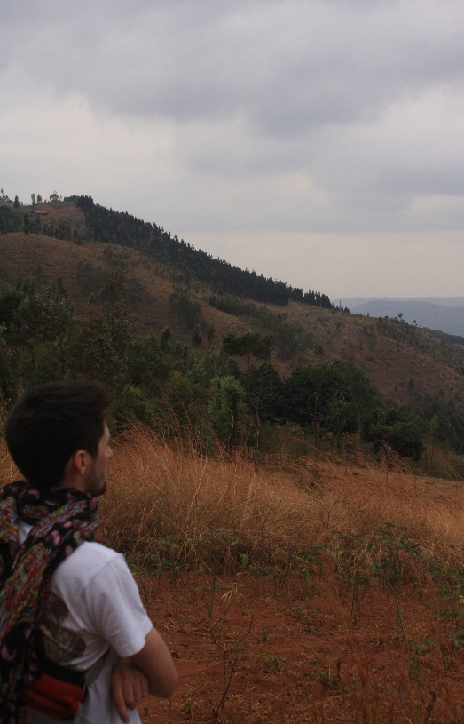
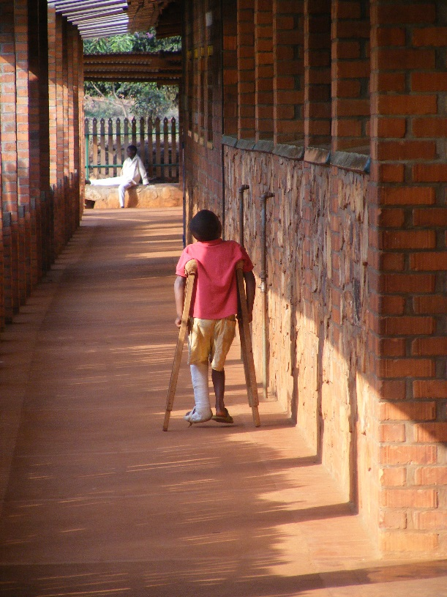
Analysis of the problem
MUTOYI MISSION
V.I.S.P.E. NGO
- Problem Tree -
source: European Commission – Project Cycle Management Guidelines

Slide 8
Goals of the thesis
Three main goals
Finding energy substitutions to traditional fuels in Burundi
Determination of the appropriate technological set-up
Analysis of the benefits of technologies and final decision
Analysis of the available and affordable energy resources in Burundi
Analysis of the context
Prefeasibility study and test of homemade solar cookers
Trnsys simulation
Economic, environmental and energy analysis
First approach Decision making process
Notes:
Strategia suggirita dall’albero dei problemi che si concretizza nei seguenti 3 obiettivi

Slide 9
1. Energy sources analysis
Fossil fuels:
Not affordable (excessive cost of diesel)
Weak supply chain (es: no gas grid)
Only used for emergency
Wind energy:
Not suitable for electric generation
Low wind speed on the hill of Mutoyi†
†source: NASA Database

Slide 10
1. Energy sources analysis
Solar energy:
2,000 kWh/m²year
140,000 m² of solar heat collectors from 2003 †
Suitable thermal applications
Biomass:
Improved Cook Stoves (ICSs)
No electrical applications
It is required to improve the efficiency of the devices which use traditional fuels
+
pollutant emissions
fuel usage, land degradation
health
children and women empowerment
Hydroelectricity:
85% of Total Installed Capacity (31.5 MW on 37MW)††
Future 700 kW plant that will supply Vispe with free electricity
Night surplus
Suitable applications during the night
† source: UNDP 2012
†† source: African Development Bank 2009

Slide 11
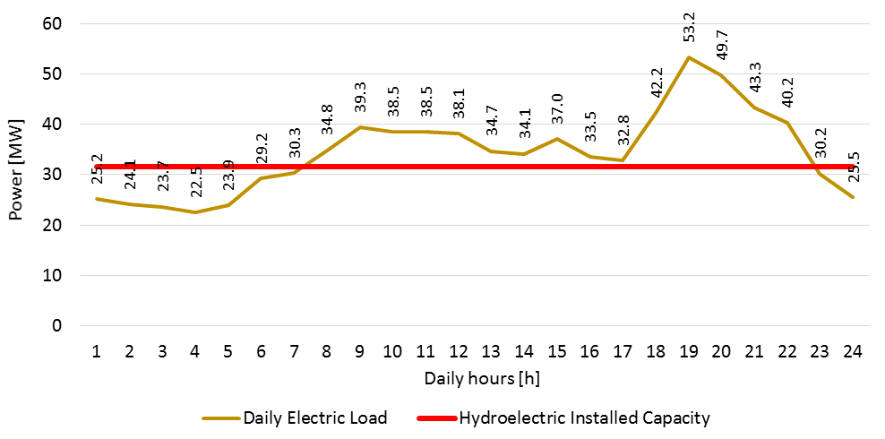
1. Energy sources analysis
source: Burundian Ministry of Energy and Mines
Night electric surplus :
Not imported energy
Actual weak electric grid NOT overloaded during the night
Notes:
Grazie al personale incontro con il Ministro Burundese dell’Energia e Miniere è stato possibile ottenere una curva del carico elettrico giornaliero che fa notare un deficit di domanda nelle ore notturne rispetto alla totale capacità idroelettrica installata. Questo ha il duplice vantaggio di svincolare il Paese dalla necessità di importare energia elettrica costosa dall’estero durante la notte ma soprattutto garantisce un approvvigionamento più sicuro di energia elettrica rinnovabile da una rete che di giorno risulta essere sottodimensionata rispetto ai picchi di domanda e che manifesta frequenti blackout. Risulta quindi vantaggioso sfruttare tale risorsa durante la notte.

Slide 12
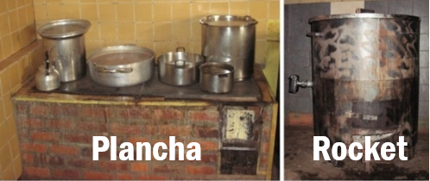
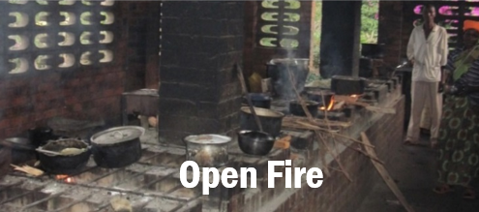
2. Determination of the appropriate technological set-up
Analysis of the context – current technologies
PaMu center
Hospital
Patients' relatives kitchen
Lunch for the hospital
- Tea and milk for patients
- Dinner for patients
Construction materials
Thermal efficiency
8 - 12%
PM emissions
CO emissions
0 mg/g_{FUEL}
0 mg/g_{FUEL}
Metal plate, bricks
Construction materials
Thermal efficiency
30 - 42 %
PM emissions
CO emissions
0 mg/g_{FUEL}
0 mg/g_{FUEL}
Metal, insulating materials, bricks
Construction materials
Thermal efficiency
10-18 %
PM emissions
CO emissions
1-2 mg/g_{FUEL}
35 - 80 mg/g_{FUEL}
stones, mud
Literature research about stoves studies and testing energy efficiencies:
Fuel use and emissions performance of fifty cooking stoves in the laboratory and related benchmarks of performance [Aprovecho Center 2010]
Solid-fuel household cook stoves: Characterization of performance and emissions [U.S. Environmental Protection Agency 2008]
Stove Performance Inventory Report [Berkeley Air Monitoring Group 2012]
Notes:
Terminata l’analisi delle risorse energetiche del Paese, per raggiunger il secondo obiettivo dello studio è necessario un’analisi approfondita del contesto.

Slide 13
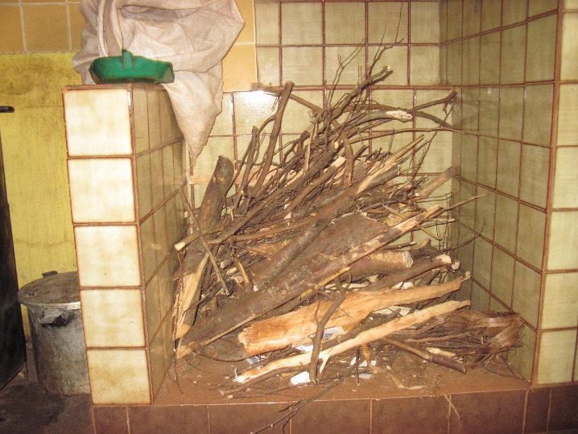

2. Determination of the appropriate technological set-up
Analysis of the context – physical properties
Need for a realistic value for the LHV
wood diffused in Burundi and used at Mutoyi: Eucalyptus
LHV_{dry} = 18 MJ/kg†
X_{H2O} is directly related to the humidity and temperature of the surrounding air
$$LHV={LHV}_{dry}\left(1−x_{H_{2}O}−x_{ASH}^{†}\right)−x_{H_{2}O}{ΔH}_{eva}=15−16 MJ/kg$$
†sources: BM Jenkins, LL Baxter, TR Miles Jr et al., “Combustion properties of biomass,” Fuel processing technology
Phyllis database (Energy Research Centre of the Netherlands). https://www.ecn.nl/phyllis2/
Notes:
La seconda analisi ha interessato le proprietà fisiche dell’eucalipto che è il legno maggiormente utilizzato in missione. Dalla lettura è si è individuato il valore di potere calirifico su base secca e, implementando una procedura tecnica del Dipartimento Americano dell’Agricoltura e Servizio Forestale, a partire dai dati di Umidità Relativa si è calcolato il contenuto d’acqua del legno e infine il valore reale di PCI per ogni mese dell’anno.

Slide 14
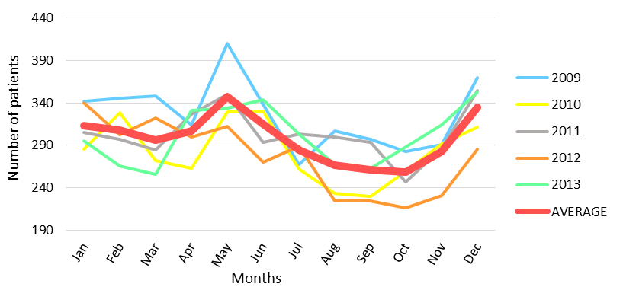
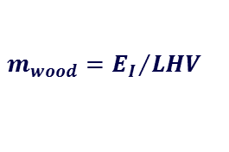



2. Determination of the appropriate technological set-up
Analysis of the context – water and wood needs
Monthly average of daily number of patients
! no data apart August 2013
Proxy is needed
→ PaMu center:
Needs constant during the year
Needs change proportionally to the number of patients
→ Hospital:
$0.6 liters per patients∗number of patients →E_{II}is known for each month$
$E_{I}=E_{II}+E_{LOOS+BOIL }$
dividing by E_{II}
with
E_{I} = primary energy of wood
E_{II} ₌ secondary energy of water
E_{LOSS} ₊ _{BOIL} = sum of boiling and lost energy
m_{wood} = mass of wood
_{LHV} = Low Heating Value of wood
$$x=1+z$$
z equal to the value of August 2013 for each
month → evaluating x for each month and E_{I}
$$E_{I}=x∗E_{II}$$
$$m_{wood}={E_{I}}/{LHV}$$
→ Patients’relatives:
NO DATA
Notes:
Per ultimi si sono analizzati i bisogni di legna e acqua della missione. Poichè gli unici dati consultabili sono quelli relative alla missione di Agosto 2013, è stato utilizzato come dato proxy la media giornaliera di pazienti ospedalizzati per estendere i dati su base annua.
Per il Pamu dove si cucina si sono identificati due scenari rispettivamente di 1) bisogni costanti durante l’anno e 2) bisogni che variano proporzionalmente al numero di ospedalizzati.
Per l’ospedale è stato possibile ricavare il bisogno di energia secondaria per ogni mese dell’anno grazie alla quantità nota di te e latte che spetta ad ogni paziente. Da un bilancio energetico sulle stufe e con l’ipotesi di perdite costanti in rapporto all’energia secondaria è stato possibile stimare il bisogno di energia primaria e quindi di legna per ogni mese dell’anno.

Slide 15
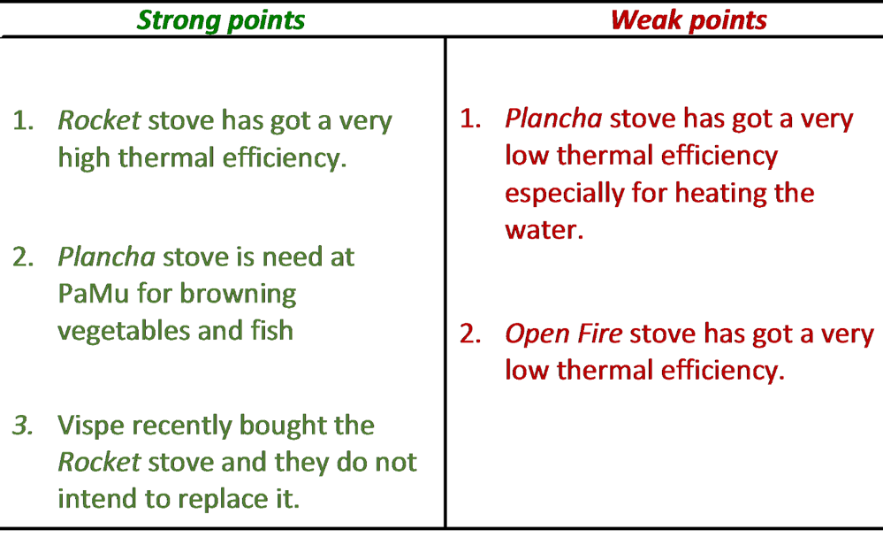
2. Determination of the appropriate technological set-up
Analysis of the context – considerations
→ Achievements
  1-2. PaMu center and the Hospital:
  technological improvements must avoid a replacement of the stoves → TECHNOLOGICAL IMPLEMENTATION FOR PREHEATING PURPOSES
  3. Patients’ relatives’ kitchen:
  the Open Fire stoves could be replaced
Notes:
Da questa analisi del contesto è possibile concludere per il PaMu e l’Ospedale che l’alta efficienza termica della stufa rocket, la necessità di utilizzo della stufa Plancha per la cottura di alcuni cibi suggeriscono l’utilizzo di un nuovo set-up tecnologico che non sostituisca completamente le stufe ma solamente la legna durante la fase di preriscaldo dell’acqua per la cottura che è quella soggetta alla maggiori perdite termiche.
Per la cucina utilizzata dai parenti non vi è nessun vincolo per la sostituzione dell’attuale tecnologia Open Fire a bassa efficienza.

Slide 16
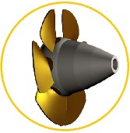

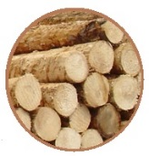
2. Determination of the appropriate technological set-up
Available and affordable energy resources
Local needs and technologies
Individuation of the new appropriate technological set-up and dimensioning
Analysis of the context – appropriate technological set-up
Electrical water heater
Heat Pump water heater + electrical resistances
Heat Pump water heater
Electrical water heater + solar
Heat Pump water heater + solar
Solar collectors and storage
PaMu center and Hospital
Patients’relatives’kitchen
Improved Cook Stoves
Solar Stoves
! Acceptability
Prefeasibility study
Notes:
….
Per le stufe solari il grande problema è l’accettabilità da parte delle persone. Per questo motivo, tale lavoro di tesi si limita solamente a testarne l’effettiva compatibilità con le condizioni climatiche burundesi e quindi suggerirne l’implementazione in un future progetto pilota.

Slide 17
2. Determination of the appropriate technological set-up
Prefeasibility study and test of homemade solar cookers
Dangerous
Expensive
PANEL STOVE
BOX STOVE
PARABOLIC STOVE
CO, PM, SO₂, fly ash, smoke savings
CO₂ reduction
Firewood reduction
Wood cost savings
Time saved
Easily and cheaply self-built
Time of day limits
It takes longer
Disruption by weather changes
Conflict with traditional three stone fire
Food outside the home
Manufacturers unknown
Notes:
Di conseguenza una parte del lavoro si è dunque concentrata sull’analisi e test sperimentale di tale tecnologia. A seguito di una breve analisi dello stato dell’arte che ne evidenzia l’aspetto critico relativo all’accettabilità, si sono individuati tre modelli principali. A causa dell’elevato costo di produzione, di acquisto e la pericolosità della stufa parabolica, tale tecnologia non si è rivelata appropriata in un contesto come quello ospedaliero di Mutoyi per la presenza di malati e bambini.

Slide 18
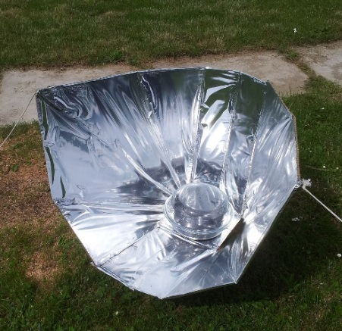
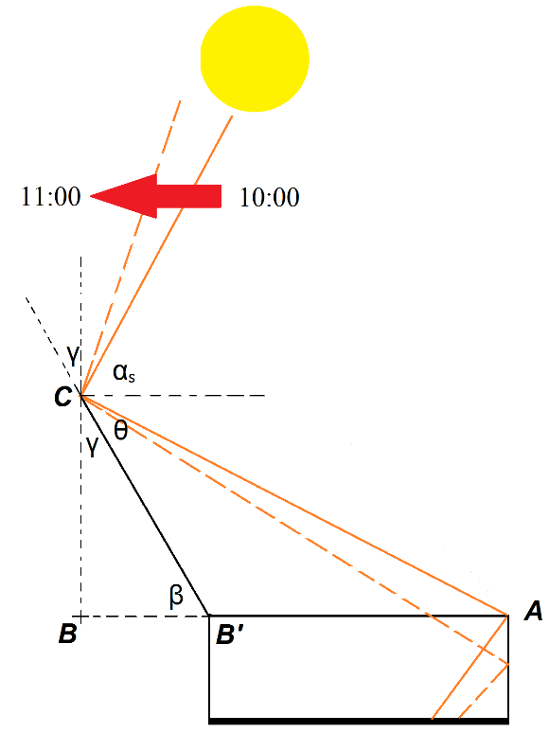
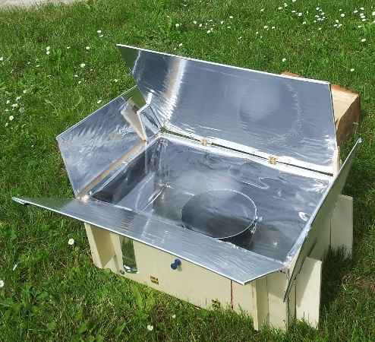
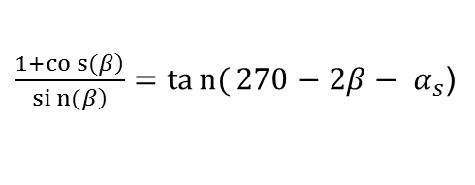
2. Determination of the appropriate technological set-up
Prefeasibility study and test of homemade solar cookers
Self construction and Optimization of solar cookers
Celestino Ruivo Panel Cooker
Engineer and Doctor of the University of Algarve
Just optimized
$\frac{\left.1+cos{(}β\right)}{\left.sin{(}β\right)}=tan{(}270−2β− α_{s}$)
with
α_{s} = solar altitude
β = tilt of the mirror
Box cooker
Notes:
Di conseguenza sono stati analizzati due modelli autocostruiti: Panel Cooker costruita e ottimizzata dall’ingegner Celestino Ruivo, docente all’università di Algarve e infine un modello Box Cooker che è stato ottimizzato attravero uno studio bidimensionale delle riflessioni sui lati della box a partire dai valori medi di altezza e zenith solare.

Slide 19

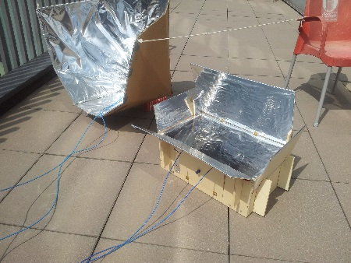
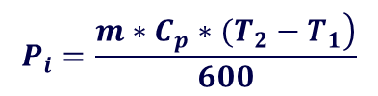

2. Determination of the appropriate technological set-up
Prefeasibility study and test of homemade solar cookers
“Standard procedure for Testing and Reporting Solar Cooker Performance” (ASAE)
Experimental campaign
11-15-16-17-18 July 2014
DEPARTMENT OF ENERGY
Variables:
Loading: 7 kg potable water per square meter intercept area
Insolation: Direct Normal Irradiation (DNI) >450W/m²
Time: 10:00 – 14:00
Recording at intervals not to exceed ten minutes: the average water temperature (ºC) of cooking vessels, solar insolation (W/m²), ambient temperature (ºC)
Calculating cooking power
with
m = load of water during the test
I_{i} = mean solar insolation
T₂= temperature of water after
ten minutes
T₁= temperature of water at
the start
T_{w} = temperature of water
T_{a} = air temperature
Reporting in a graphic P_{s} as a function of the difference between the water and the air temperature ($T_{d} = T_{w}–T_{a}$)
The Mean Cooking Power is defined as the value of P_{s} evaluated at a T_{d} equal to 50 ºC that represents the integral average of the power on the time
Notes:
! Dico perchè 700 W/sm

Slide 20
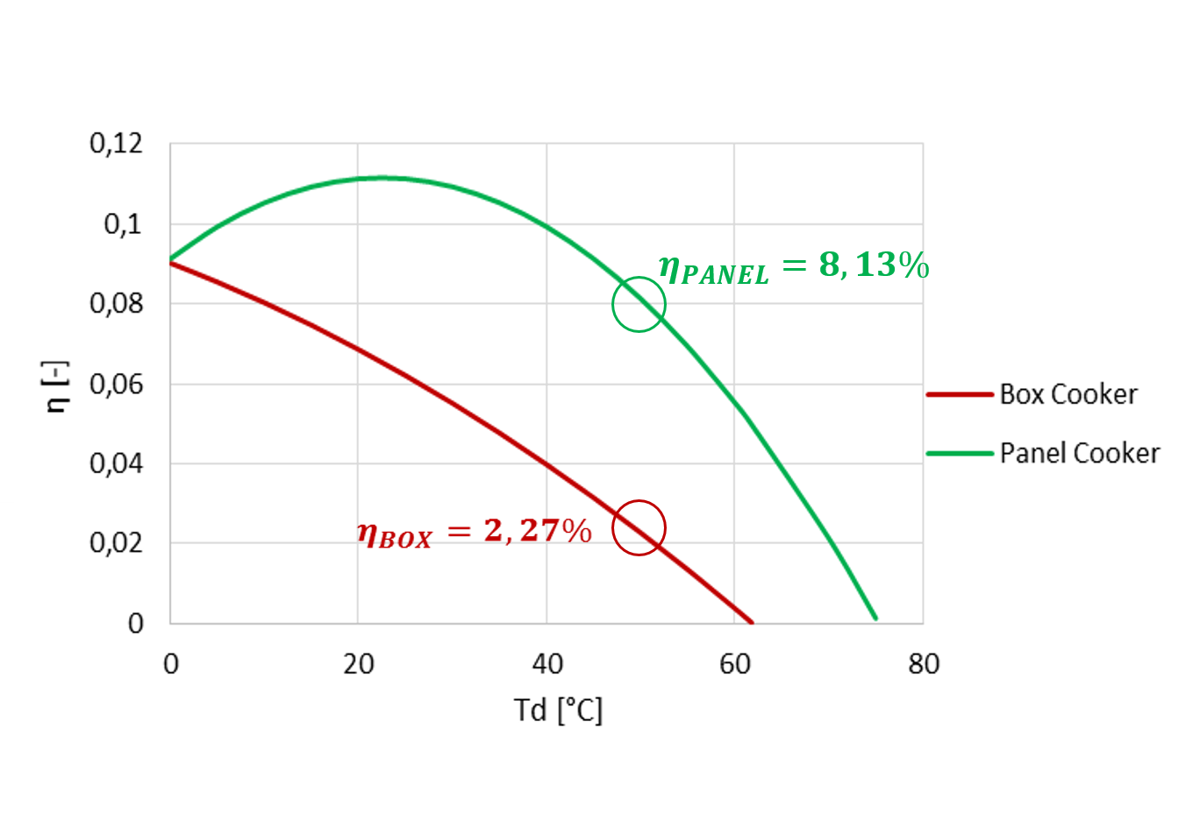
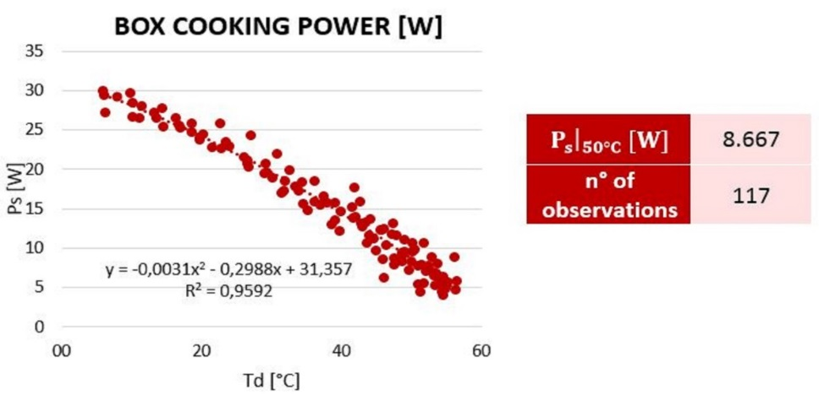

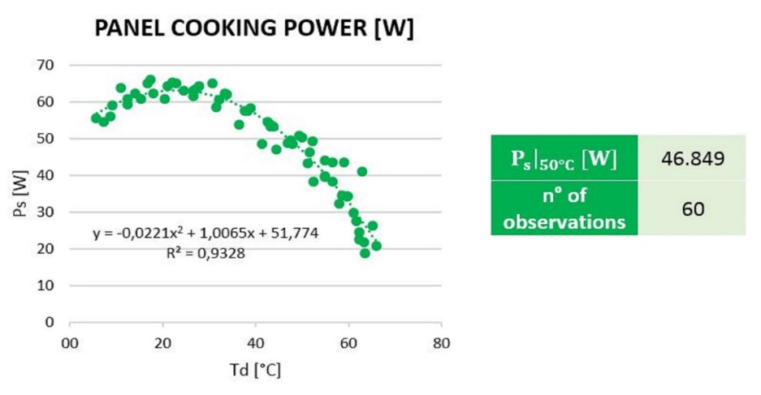
2. Determination of the appropriate technological set-up
Prefeasibility study and test of homemade solar cookers
Experimental campaign
11-15-16-17-18 July 2014
DEPARTMENT OF ENERGY

Slide 21
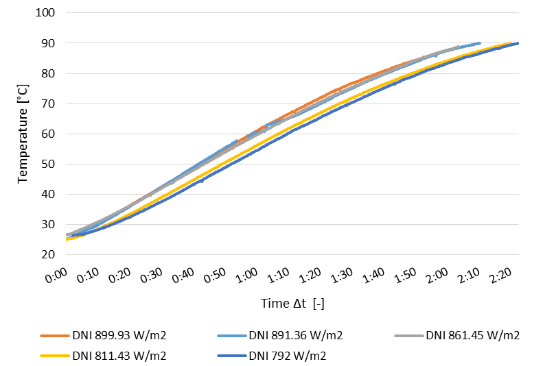
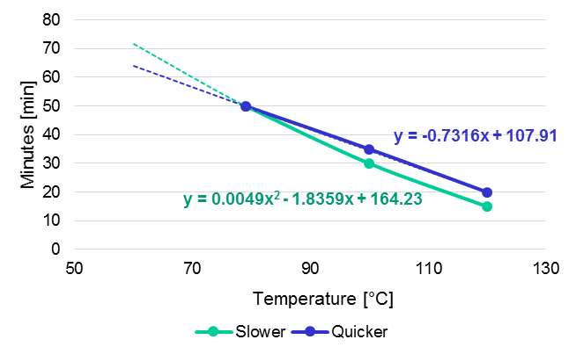


2. Determination of the appropriate technological set-up
Prefeasibility study and test of homemade solar cookers
Test of cooking time for Panel Stove
Experimental campaign
11-15-16-17-18 July 2014
DEPARTMENT OF ENERGY
1)
$$E=Q_{w}+Q_{b}$$
E = total energy required to bring water and beans from 20 ºC to 90 ºC
Q_{w} = energy required to bring 400 ml of water from 20 ºC to 90 ºC
Q_{b} = energy required to bring 300 g of beans from 20 ºC to 90 ºC
η_{PANEL}
I_{BURUNDI} P_{s}
I_{BURUNDI} = Monthly Averaged Midday Direct Normal Irradiation [W/m²]†
Dividing E by P_{s}, the monthly mean time required to cooking beans can be estimated: 61 – 74 min
2)
60 – 72 min
Experimental test → Δt ~ [+4%÷+9%]
3)
†source: NASA Database
Notes:
Non avendo dati si sono interpolati i dati ottenuti dalla letteratura
Tali valori sono stati sottoposti a test sperimentali qui al Politecnico che forniscono una prima indicazione di validità del modello implementato
Di conseguenza è possibile concludere che se da una parte la stufa a box risulta essere del tutto inappropriata, per la stufa a pannello, i valori confortanti relativi ai tempi di cottura suggeriscono una possibile implementazione di un progetto pilota per testare tale tecnologia in loco.

Slide 22
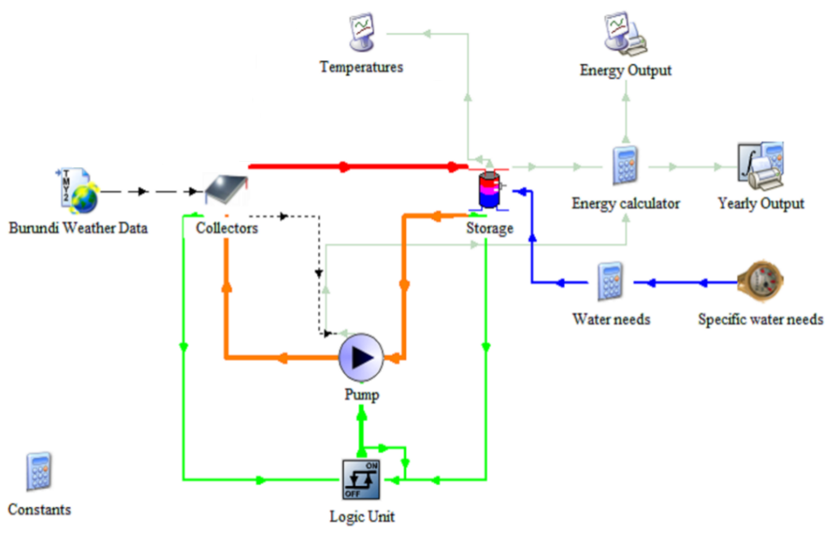
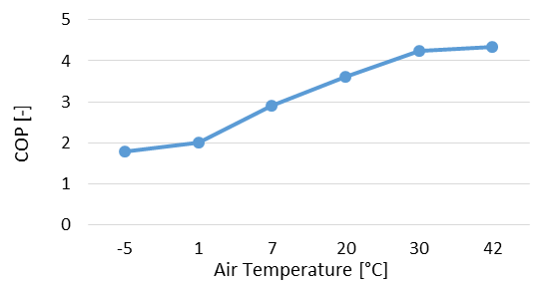

3. Analysis of the benefits of Technologies and final decision
Trnsys simulation
Temperature on the storage (ºC)
Example of dimensioning of heat pump water heater
Tilt of surface (Solar Electricity Handbook) → 20°
Monthly Electrical consumptions (kWh)
Physical properties and performances
source: ARISTON NUOS EVO SPLIT 200l
Interpolating the values of the HEATING RATING, TIME HEATING and COP it is possible to estimate the real values of them for each month on the base of the air temperature
Dividing the HEATING RATING by the COP we obtain the ELECTRICAL POWER CONSUMPTIONS for each month
Weather and solar geometry data (METEONORM)
Hourly water needs
$$P_{el}= \frac{Q_{u}}{COP}$$
with Q_{u} = Heating Rating
input
output
Notes:
Conclusa l’analisi delle stufe ritorniamo al terzo obiettivo della tesi che è l’analisi dei benefici delle stufe e implementazione di un primo tentative di scelta

Slide 23






3. Analysis of the benefits of Technologies and final decision
Energy analysis of technologies
CRITERION 1
PaMu and Hospital solution
$$E_{II}= m_{H_{2}O}∗C_{p}∗\left(T_{tech}− T_{aquifer}\right)$$
E_{II} = secondary energy of water [MJ]
T_{tech} = max. temper. of technology [ºC]
$Δm_{wood}$= wood mass saved [kg]
m_{wood} = wood actually used [kg]
$η_{STOVE}$ = efficiency of the stove [-]
$LHV$ = Low Heating Value [MJ/kg]
$S_{wood}$ = savings of wood [%]
with
$$Δm_{wood}= \frac{E_{II}}{η_{STOVE}}∗\frac{1}{LHV}$$
$$S_{wood}=\frac{Δm_{wood}}{m_{wood}}$$
Patients’relatives kitchen
$E_{II_{OF}}= E_{II_{ICS}}$← secondary energy balance
with
OF = Open Fire
ICS = Improved Cook Stove
$$E_{I_{OF}}∗η_{OF}= E_{I_{ICS}}∗η_{ICS}$$
$$m_{wood_{OF}}∗LHV∗η_{OF}= m_{wood_{ICS}}∗LHV∗η_{ICS}$$
$$\frac{m_{wood_{ICS}}− m_{wood_{OF}}}{m_{wood_{OF}}}= 1−\frac{η_{OF}}{η_{ICS}}$$
S_{wood}

Slide 24
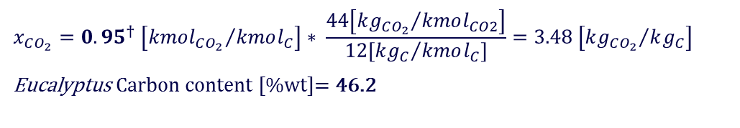

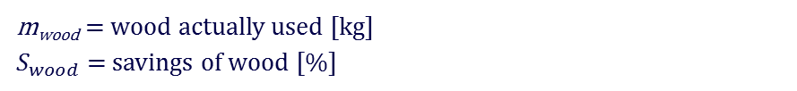
3. Analysis of the benefits of Technologies and final decision
Environmental and Economic Analysis
CRITERION 2
Greenhouse emissions
$$x_{CO_{2}}={0.95}^{†} \left[{kmol_{CO_{2}}}/{kmol_{C}}\right]∗ \frac{44\left[{kg_{CO_{2}}}/{kmol_{CO2}}\right]}{12\left[{kg_{C}}/{kmol_{C}}\right]}=3.48 \left[{kg_{CO_{2}}}/{kg_{C}}\right]$$
Eucalyptus Carbon content [%wt]= 46.2
$$S_{CO_{2}}= {S_{wood}∗m}_{wood}∗0.462∗3.48∗x_{CO_{2}}$$
with
m_{wood} = wood actually used [kg]
$S_{wood}$ = savings of wood [%]
Economic analysis
CRITERION 3
Money savings for wood supply = S_{wood} * yearly_cost_of_wood
CRITERION 4
Cost of Electricity =
E _{el} [kWh]* FBU/kWh††
with
$S_{wood}$ = savings of wood [%]
E_{el} = Electric energy consumed [kWh]
CRITERION 5
Investment (cost of technology)
† source: Mark Bryden, Mike Van, Jayme Vineyard 2005
Nordica MacCarty, Damon Ogle, Dean Still 2008
BM Jenkins, LL Baxter, TR Miles Jr 1998
† † source: Burundian Ministry of Energy and Mines
Notes:
Per completare l’analisi si è fatta una stima delle emission ….
e….

Slide 25
3. Analysis of the benefits of Technologies and final decision
Results
COMPLEXITY OF CHOICE
Notes:
Finita l’analisi, è stato riportato il valore di risparmio di legna per la soluzione che prevede le ICS per la cucina utilizzata dai parenti e per le 6 tecnologie di prima che vengono ora confrontate sulla base di 5 criteri

Slide 26
3. Analysis of the benefits of Technologies and final decision
First approach to a decision making process
First analysis - QUANTITATIVE INDICATORS
HP: 700kW hydroelectric plants will be realized
Reduction in the use of wood biomass
Investments
Money savings for the supply of wood
Cost of electricity
Creation of Capacity Building and dissemination of new technical know how
Reduction in the use of wood biomass
Investments
Money savings for the supply of wood
Cost of electricity
Creation of Capacity Building and dissemination of new technical know how
Reduction in the use of wood biomass
Investments
Money savings for the supply of wood
Cost of electricity
Creation of Capacity Building and dissemination of new technical know how
ENVIRONMENTAL
ECONOMIC
SOCIAL
SOCIAL
Electrical Water Heater with solar integration
Electrical Water Heater
Electrical Water Heater with solar integration
Notes:
Per la scelta non è stato implementato un Decision Support System convenzionale ma un primo approccio basato sulla valutazione di 5 criteri stabiliti con il maggiore stakeholder Vispe che ha permesso di mettere a punto una procedura che partisse dall’analisi dei soli criteri quantitativi utilizzando una logica ingegneristica e andando a identificare i criteri qualitativi come criteri di boundery.

Slide 27
3. Analysis of the benefits of Technologies and final decision
First approach to a decision making process
Second analysis – SOCIAL INDICATORS and DIFFUSION
Reduction in the use of wood biomass
Investments
Money savings for the supply of wood
Cost of electricity
Creation of Capacity Building and dissemination of new technical know how
Reduction in the use of wood biomass
Investments
Money savings for the supply of wood
Cost of electricity
Creation of Capacity Building and dissemination of new technical know how
Reduction in the use of wood biomass
Investments
Money savings for the supply of wood
Cost of electricity
Creation of Capacity Building and dissemination of new technical know how
8300 +8300 – 1150 – 910 = …
Heat pump water heater + solar
Is all of this worth less than € 14,000?
Notes:
Il secondo step introduce invece gli aspetti sociali di creazione e diffusione di nuova capacity building. Inoltre, in un progetto di cooperazione è fondamentale valutarne l’impatto sul territorio e quindi la possibilità di diffusione. Questo impedisce di escludere la voce relative ai costi dell’elettricità. Ricordando poi la possibilità di ricevere un finanziamento esterno, la tecnologia che permette di ottenere i più alti risparmi di legna con addirittura un maggior risparmio nell’acquisto di legna superiore al costo dell’elettricità è la pompa di calore con e senza integrazione solari. Inoltre questa tecnologia permetterebbe la diffusione di nuove conoscenze tecniche relative al funzionamento della pompa di calore e del solare termico che ha il grosso vantaggio di poter essere autocostruito con materiali locali e quindi favorire la nascita di una nuova imprenditoria locale.
Concludendo, se da una parte lo scaldacqua elettrico sembra essere la soluzione più appropriata per il contesto locale di Mutoyi, dall’altra la tecnologia della pompa di calore integrata con solare termico permette di raggiungere una serie di benefici in termini sociali e di impatto sul territorio che in un progetto di cooperazione non devono essere trascurati. In caso di mancato finanziamento è lecito quindi concludere con questa domanda: tutto ciò vale meno di un investimento iniziale superiore a 14000€?

Slide 28
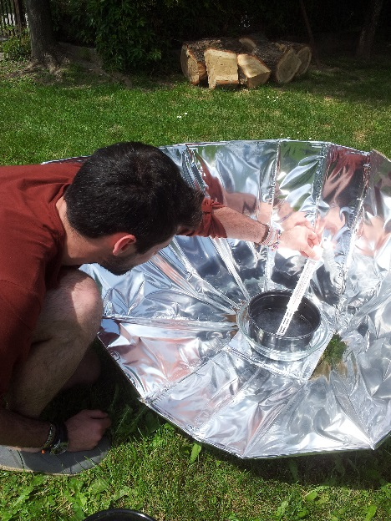
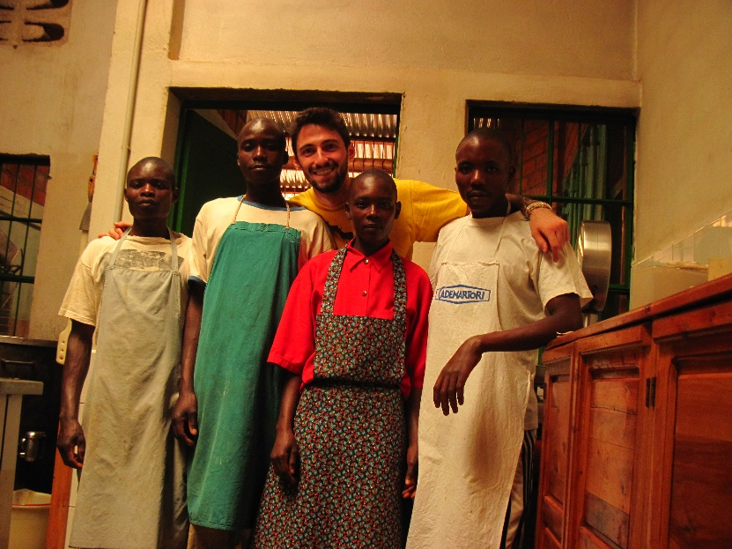
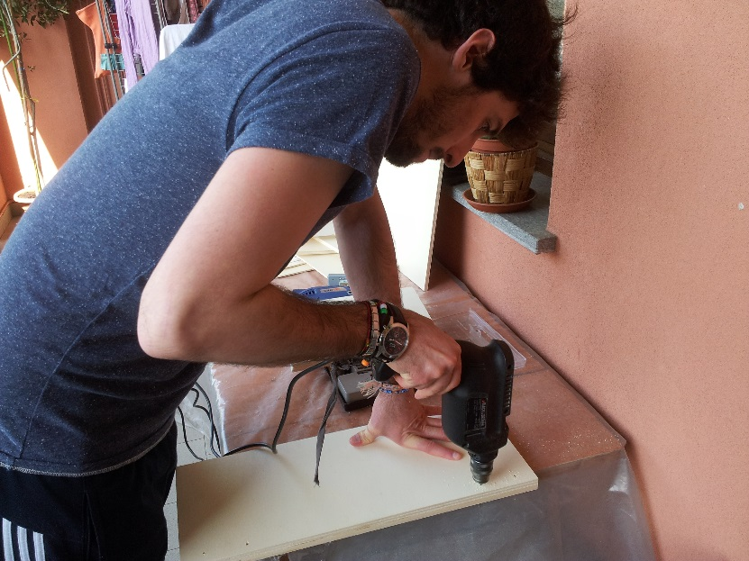
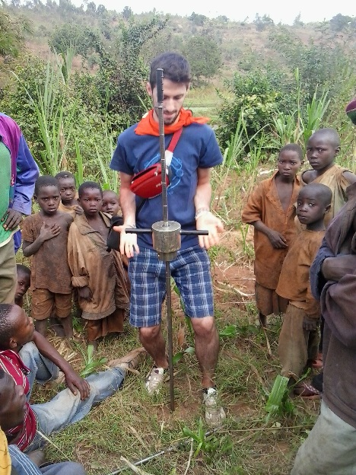
Thank you for your attention
Grazie VISPE e FLAEI

Slide 29
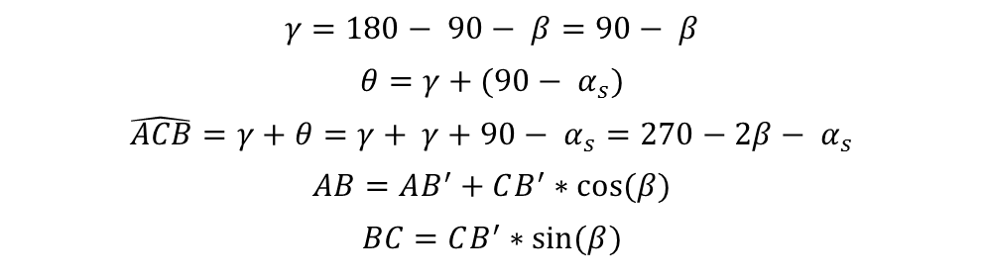
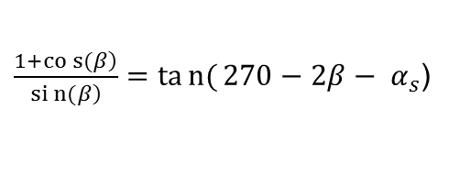

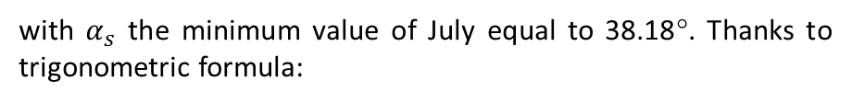
$$γ=180− 90− β=90− β$$
$$θ=γ+(90− α_{s})$$
$$\hat{ACB}=γ+θ=γ+ γ+90− α_{s}=270−2β− α_{s}$$
$$AB=AB^{′}+CB^{′}∗cos⁡(β)$$
$$BC=CB^{′}∗sin⁡(β)$$
with $α_{s}$ the minimum value of July equal to 38.18°. Thanks to trigonometric formula:
$$\frac{AB}{BC}=tan⁡(\hat{ACB)}$$
and finally, considering that $AB^{′}=CB^{′}$:
$\frac{\left.1+cos{(}β\right)}{\left.sin{(}β\right)}=tan{(}270−2β− α_{s}$)

Slide 30
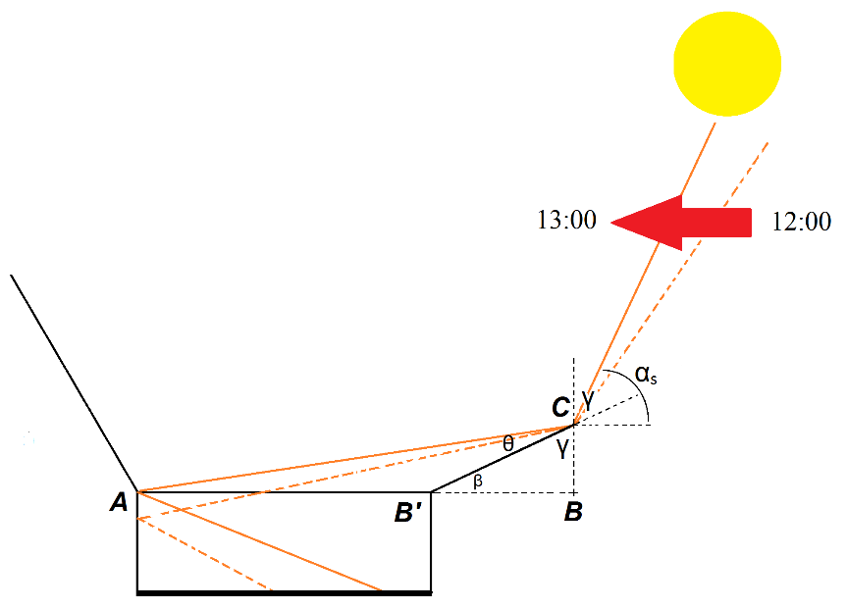
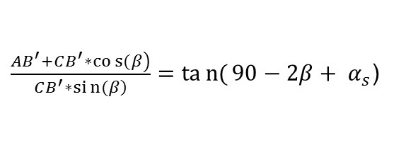
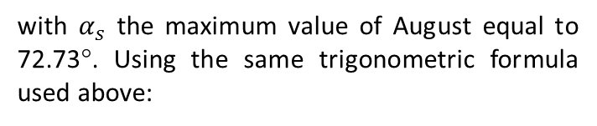
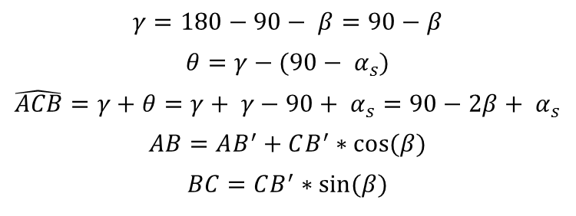
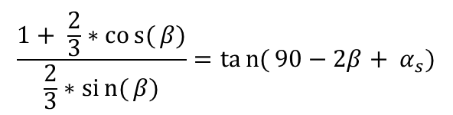
$$γ=180−90− β=90−β$$
$$θ=γ−(90− α_{s})$$
$$\hat{ACB}=γ+θ=γ+ γ−90+ α_{s}=90−2β+ α_{s}$$
$$AB=AB^{′}+CB^{′}∗cos⁡(β)$$
$$BC=CB^{′}∗sin⁡(β)$$
with $α_{s}$ the maximum value of August equal to 72.73°. Using the same trigonometric formula used above:
$\frac{\left.AB^{′}+CB^{′}∗cos{(}β\right)}{\left.CB^{′}∗sin{(}β\right)}=tan{(}90−2β+ α_{s}$)
$$\frac{1+ \frac{2}{3}∗cos{(}β)}{\frac{2}{3}∗sin{(}β)}=tan{(}90−2β+ α_{s})$$

Slide 32
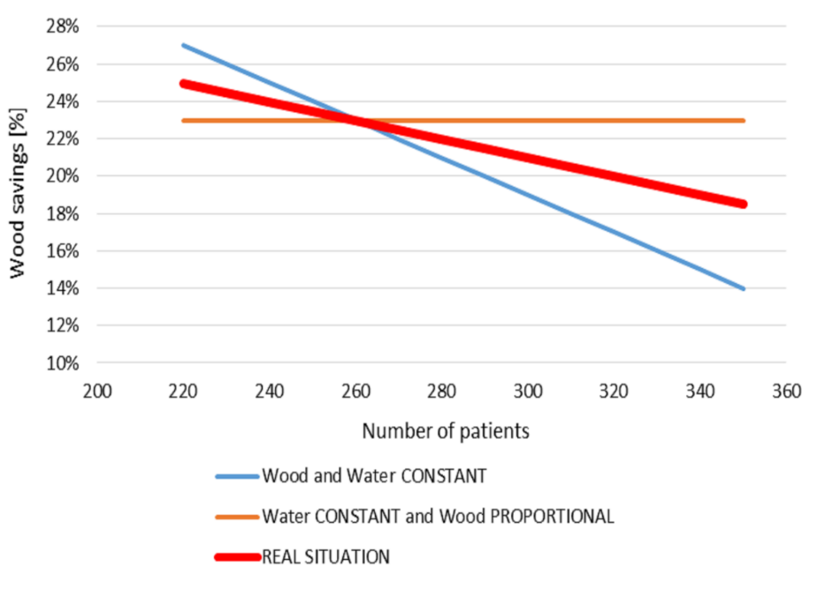

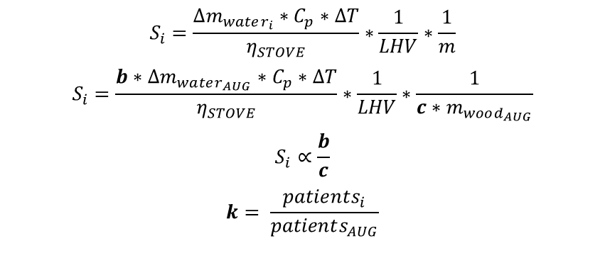
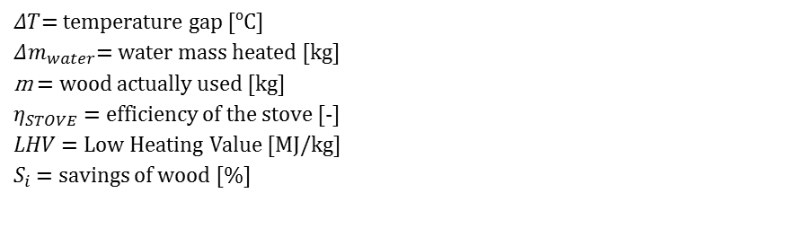
$$S_{i}=\frac{∆m_{water_{i}}∗C_{p}∗∆T}{η_{STOVE}}∗\frac{1}{LHV}∗\frac{1}{m}$$
$$S_{i}=\frac{b∗∆m_{water_{AUG}}∗C_{p}∗∆T}{η_{STOVE}}∗\frac{1}{LHV}∗\frac{1}{c∗m_{wood_{AUG}}}$$
$$S_{i}∝\frac{b}{c}$$
$$k= \frac{patients_{i}}{patients_{AUG}}$$
with
$ΔT$= temperature gap [ºC]
$Δm_{water}$= water mass heated [kg]
m = wood actually used [kg]
$η_{STOVE}$ = efficiency of the stove [-]
$LHV$ = Low Heating Value [MJ/kg]
$S_{i}$ = savings of wood [%]
$$1 ≤c ≤k$$
$$1 ≤b ≤c$$

Slide 33
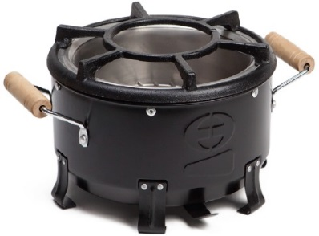




Wood or charcoal - which is better?
$$wood :1 kg ∗ 15\frac{MJ}{kg}∗15\% =2,25 MJ$$
$$wood :1 kg ∗ 15\frac{MJ}{kg}∗10\% = 1,2 MJ$$
wood
LHV
Efficiency of the stove
charcoal$:1kg∗30\%∗28\frac{MJ}{kg}∗20\%=1,68 MJ$
charcoal$:1kg∗20\%∗28\frac{MJ}{kg}∗15\%=0,84 MJ$
conversion
Source: J.D. Keita - Regional Forestry Officer at the FAO Regional Office for Africa, Accra, Ghana

Slide 34
 | Hospital |  |  | PaMu
 | Only solar collectors | Solar collectors and electrical water heater | Solar collectors and heat pump | Only solar collectors | Solar collectors and electrical water heater | Solar collectors and heat pump
Jan | 47.9 | 75.5 | 64.4 | 47.9 | 75.4 | 63.3
Feb | 50.1 | 76.1 | 65.7 | 50.1 | 75.9 | 64.4
Mar | 53.2 | 77.9 | 69.3 | 53.2 | 77.3 | 66.9
Apr | 54.8 | 77.8 | 69.6 | 54.8 | 77.1 | 66.6
May | 60.2 | 79.0 | 73.3 | 60.2 | 78.2 | 69.4
Jun | 65.4 | 81.8 | 78.2 | 65.4 | 80.4 | 73.4
Jul | 61.7 | 79.9 | 74.7 | 61.7 | 78.9 | 70.7
Aug | 62.5 | 80.7 | 75.8 | 62.5 | 79.4 | 71.6
Sep | 56.7 | 78.7 | 71.7 | 56.7 | 78.0 | 68.4
Oct | 54.6 | 78.0 | 71.1 | 54.6 | 77.5 | 67.4
Nov | 45.9 | 75.8 | 64.2 | 45.9 | 75.6 | 62.8
Dec | 45.8 | 75.2 | 62.8 | 45.8 | 75.1 | 62.2

